Slide 1
Pancasila as the Ethical Basic in Developing Science and Technology Session 04
Course : CB Pancasila
Effective Period : 2017

Slide 2
Student will be able to explain Pancasila as the ethical basic in developing science and technology
Learning Objectives

Slide 3
Knowledge and Science
Humans have the ability to reason
The ability to reason allows the development of knowledge
The ability to reason allows man made distance between subject and object
Science is a manifestation of human reasoning ability

Slide 4
Ambivalence of Science and Technology
The Progress optimism of science and technology
The victory of science in the world
Problem of value free in science

Slide 5
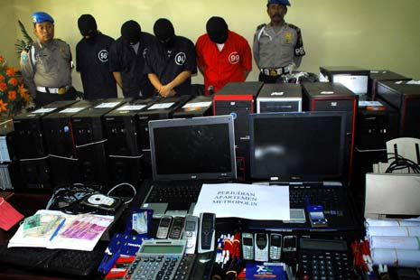
Abuse of Science and Technology
Technology in general
Computer abuse (cyber crime etc)
http://eptikbsipwt.blogspot.co.id/2013/05/#

Slide 6
Pancasila as the Basic Ethics in Developing Science and Technology
Pancasila as the Basic Ethics
The ethics of Pancasila is about the basic values of Indonesians :
1st value : Believe in God
2nd value : Humanity
3rd value : Nationality
4th value : Democracy
5th value : Justice

Slide 7
Pancasila as the Basic Ethics in Developing Science and Technology
Science and technology should bring people to the Creator (God).
Science and technology should increase the humanity.
Science and technology should promote the spirit of togetherness.
Science and technology should help the progress of democracy.
Science must create justice for all human beings.

Slide 8
Discussion
Could you describe the application of Pancasila as The Basic Ethics in Developing Science and Technology

Slide 9

Case Study:
Read the article based on the following link ….
And give your opinion
http://nasional.kompas.com/read/2017/02/14/09055481/media.sosial.penyebaran.hoax.dan.budaya.berbagi.

Slide 10
Question and Answer
?

Slide 11
References
Tim Penulis CB: Pancasila (2014). Diktat Kuliah Character Building: Pancasila. Binus University: CBDC, 000
Materi Ajar Matakuliah Pendidikan Pancasila (2013). Buku Modul Kuliah Pancasila oleh Direktorat Pembelajaran dan Kemahasiswaan Direktorat Jenderal Pendidikan Tinggi Depdiknas , Kementerian Pendidikan dan Kebudayaan RI.
Gambar pria bertopeng dam polisi: http://eptikbsipwt.blogspot.co.id/2013/05/#
case study: http://nasional.kompas.com/read/2017/02/14/09055481/media.sosial.penyebaran.hoax.dan.budaya.berbagi.

